Slide 1
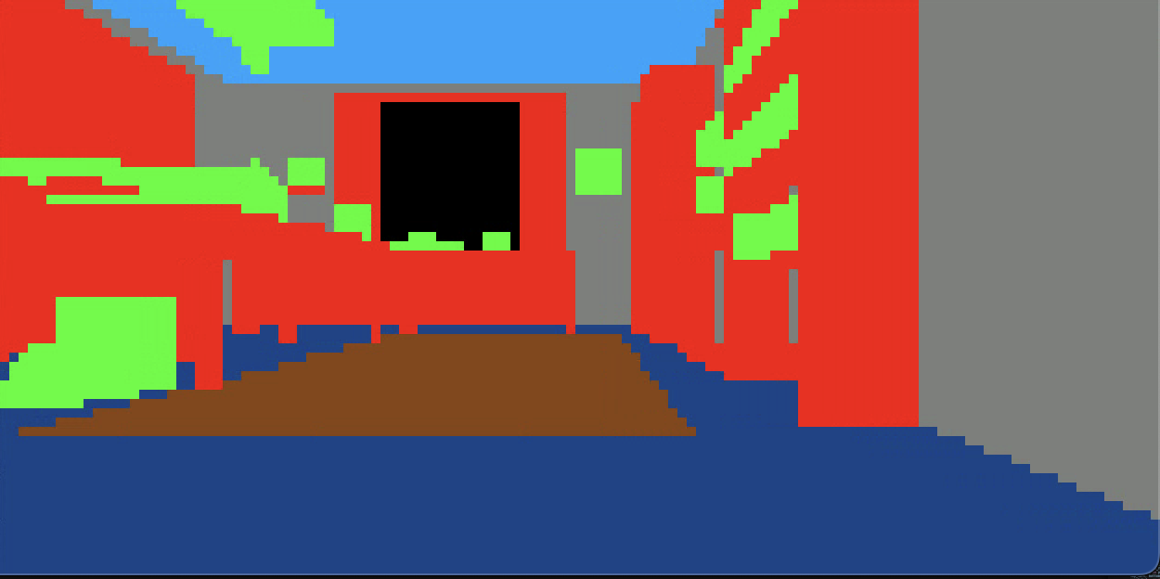
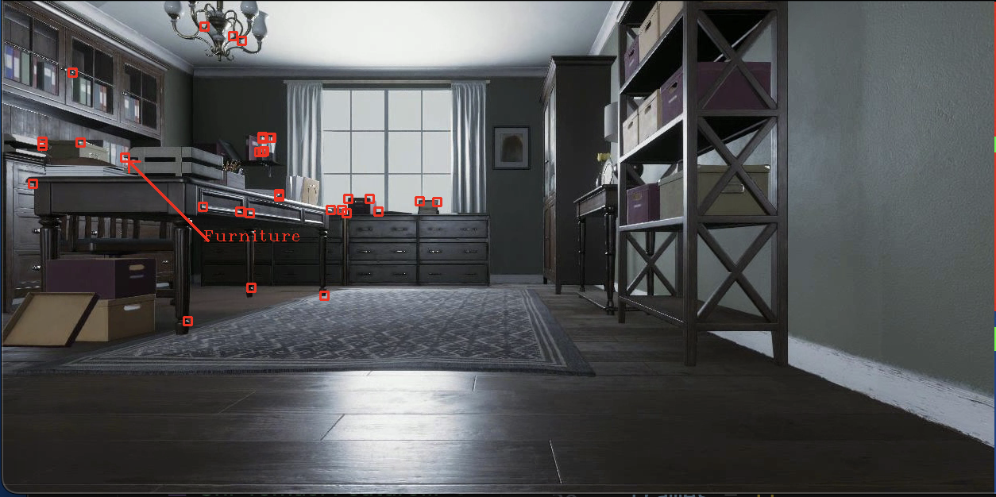
Introducing DL to vSLAM
Feature filtering with AI
December 4, 2024
Liam Loughead

Slide 2
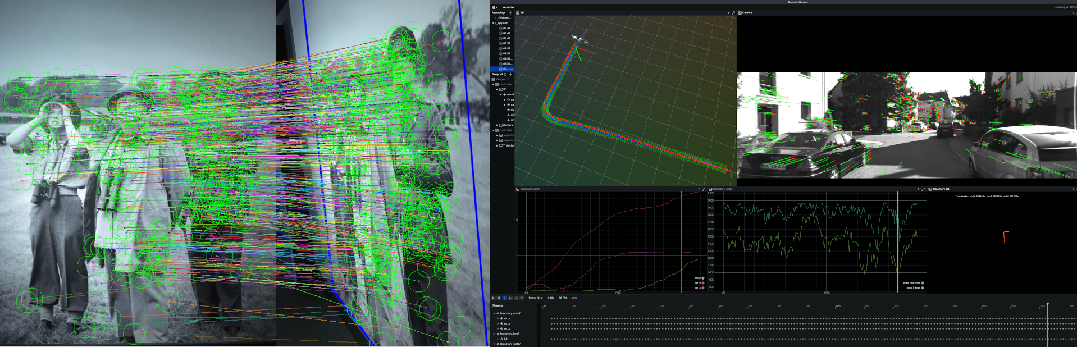
An overview of vSLAM
Mapping
Tracking & VO
Feature detection

Slide 3
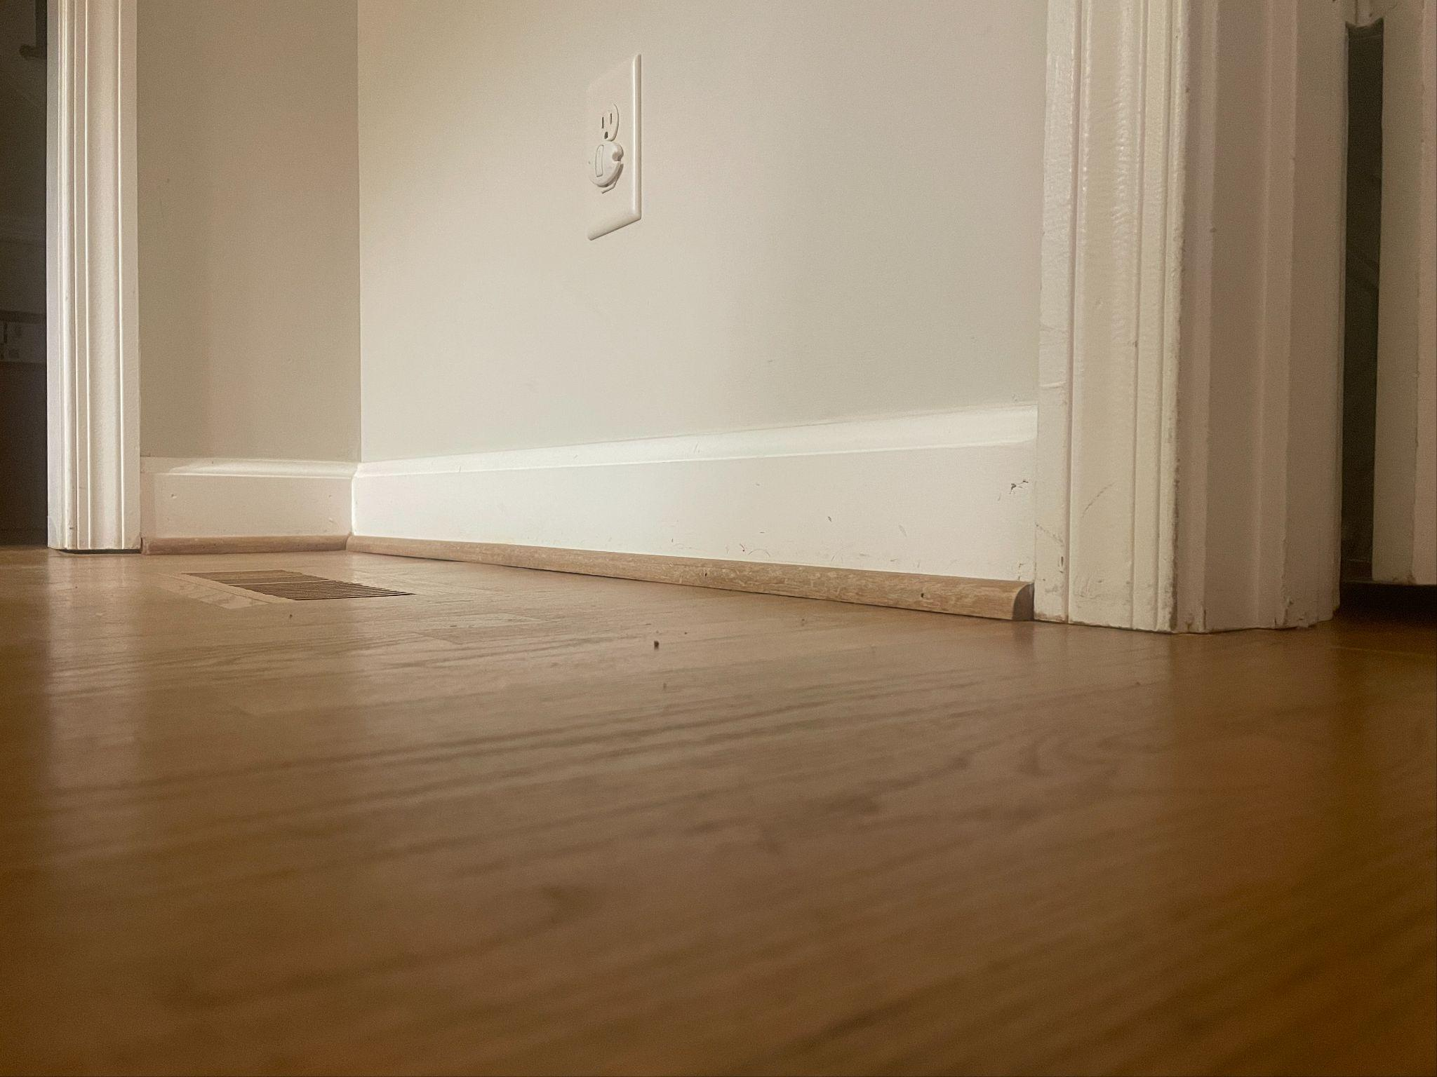
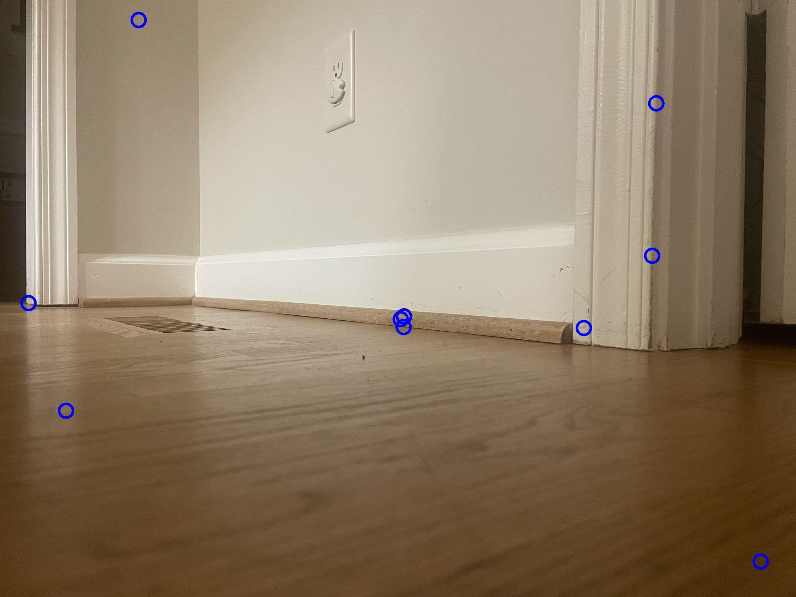
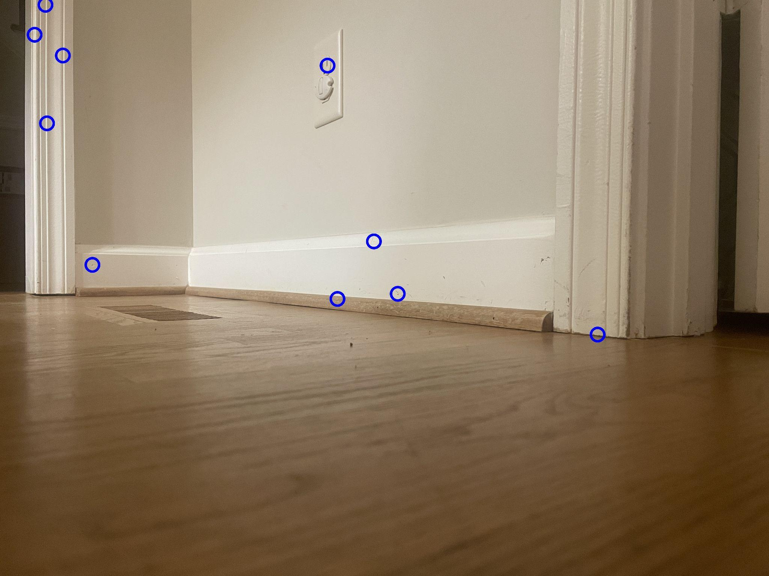
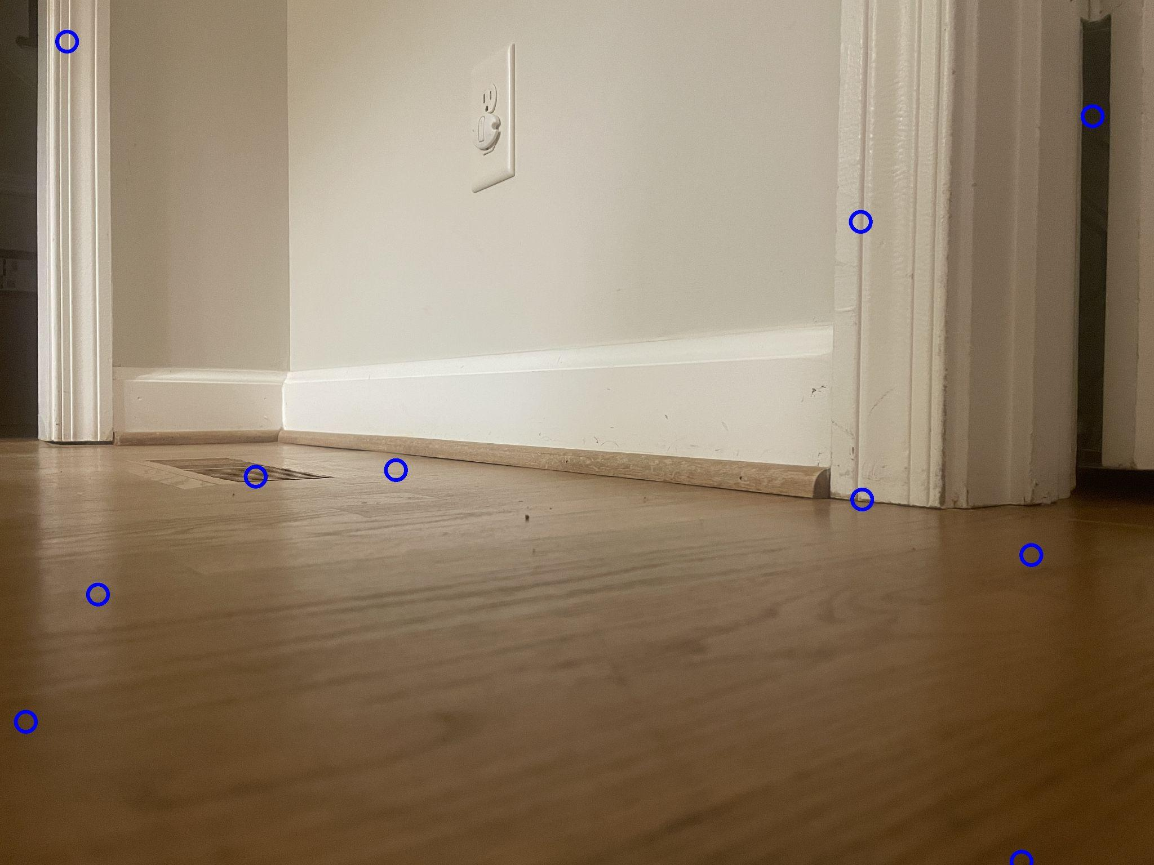
Feature detection
Original image
surf

Slide 4
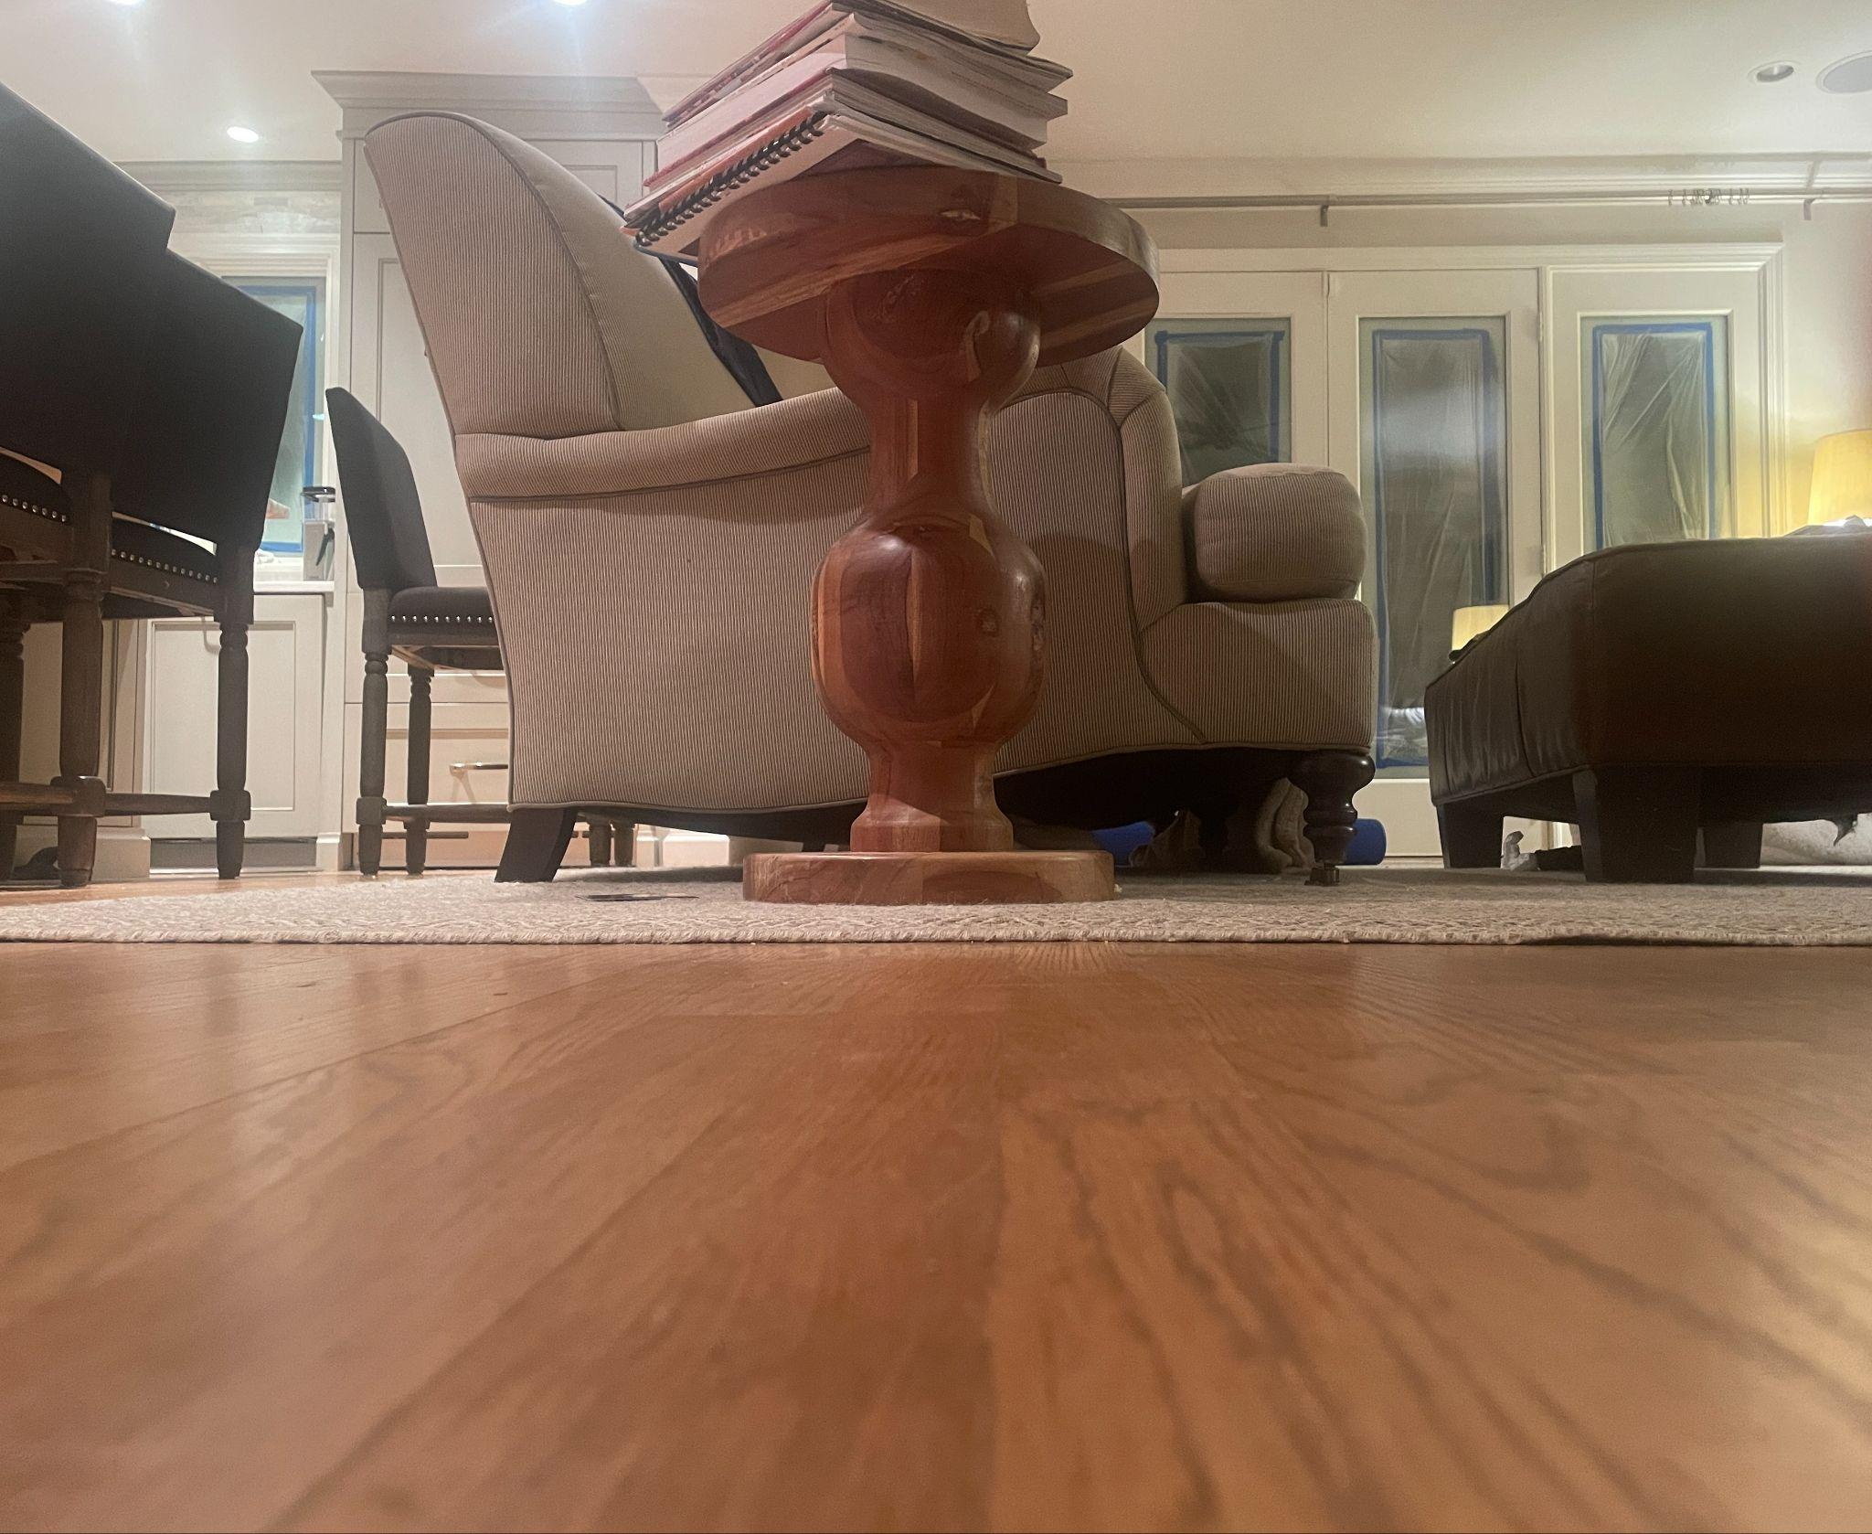
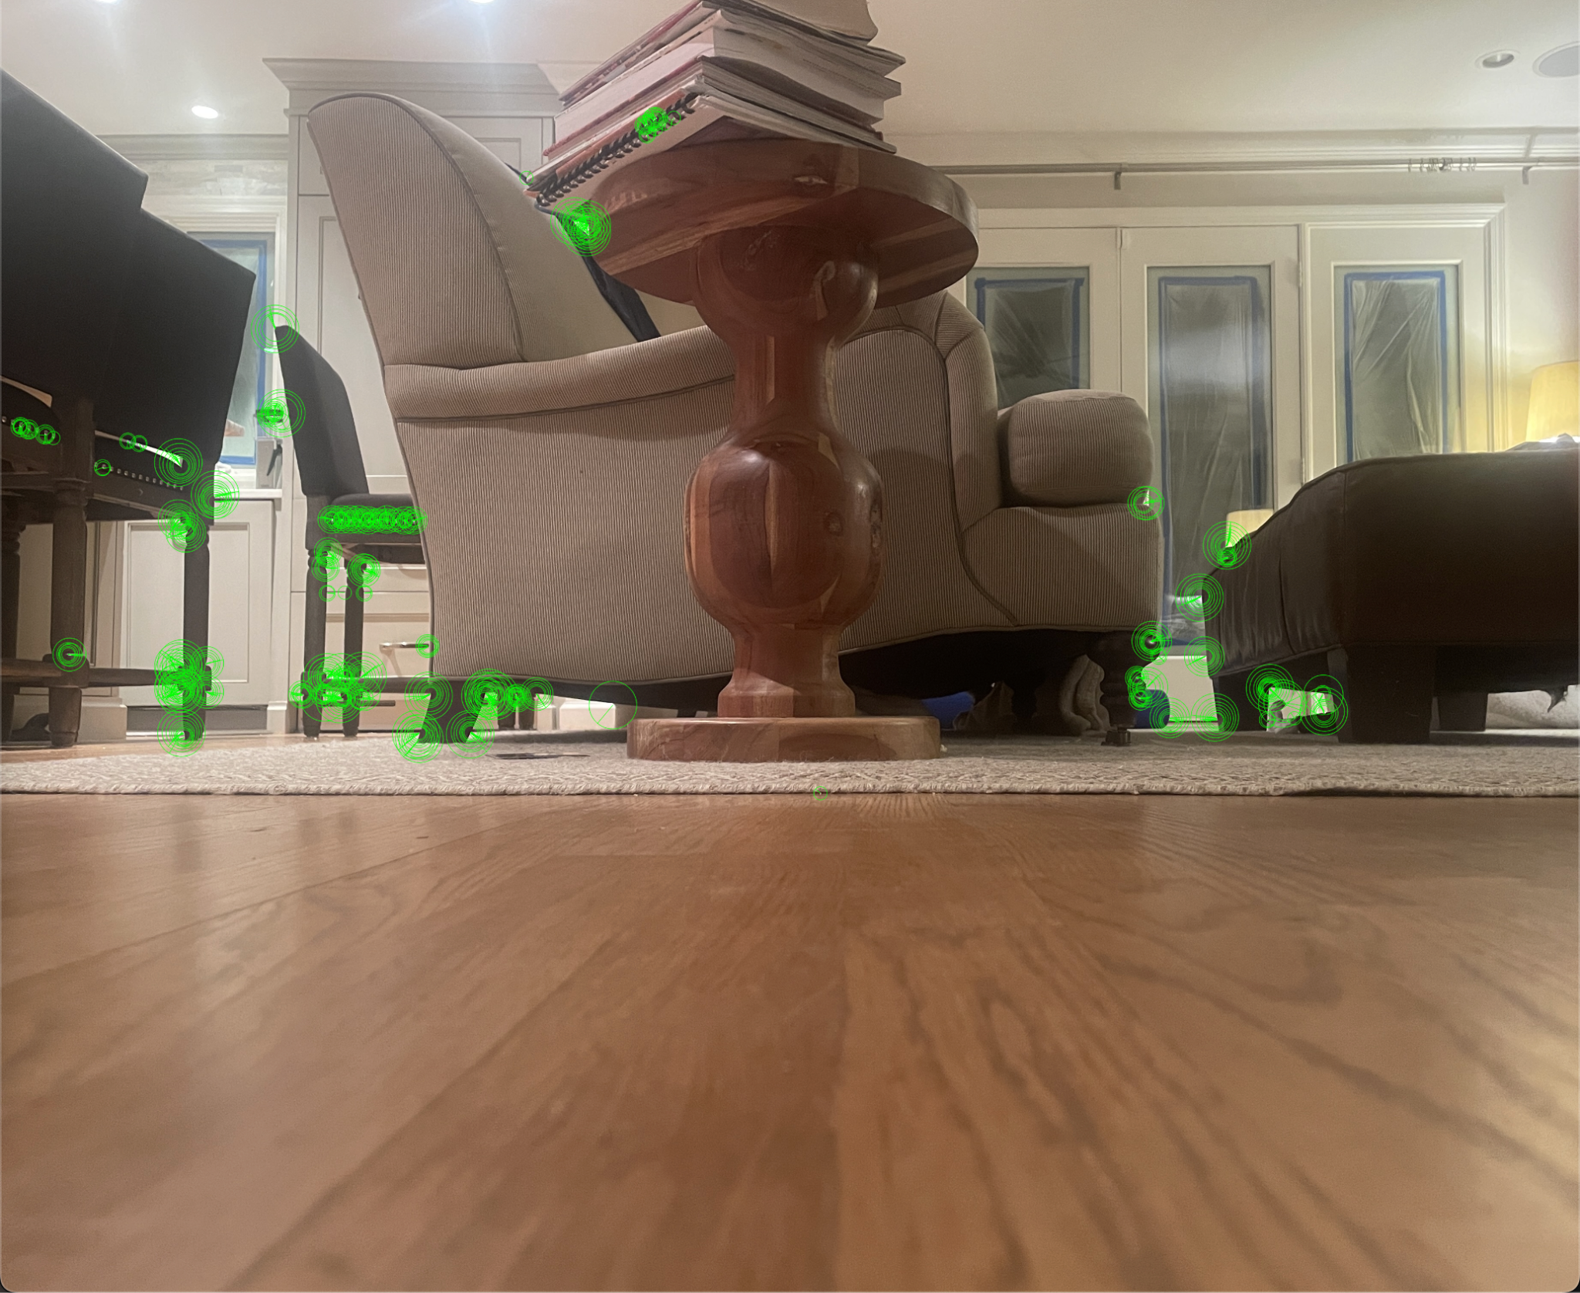
Problems with feature detection
Lighting
Orientation
Scale
Correspondence to real world positions

Slide 5


Solution: Deep Learning
Given a 10x10 grid of pixels, estimate the “permanence” of the feature
A wall corner - permanent
Books on a table - not permanent

Slide 6
Process

Slide 7
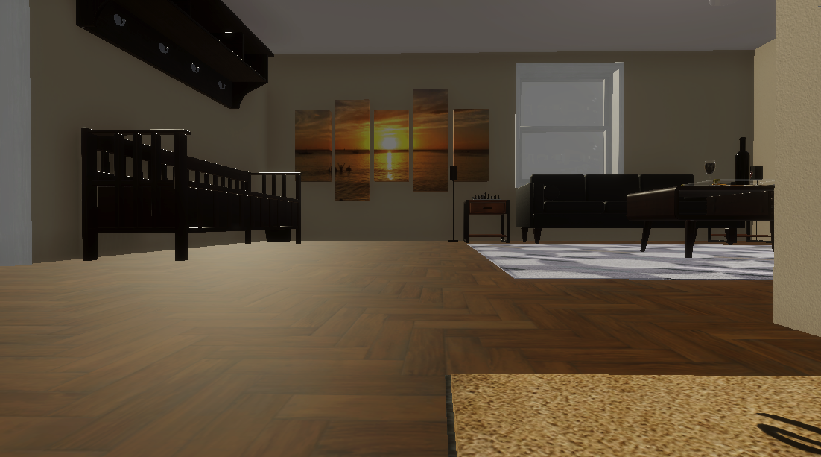
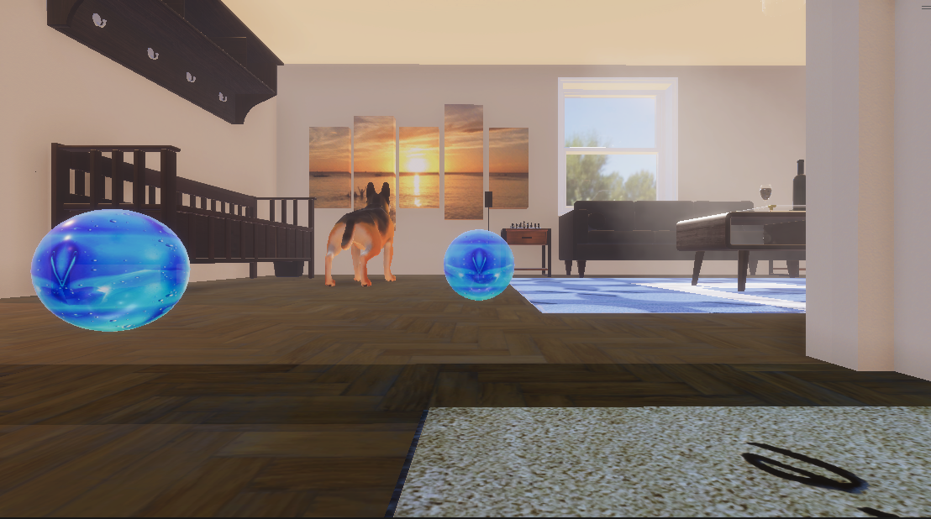
Generating synthetic data with Unity

Slide 8
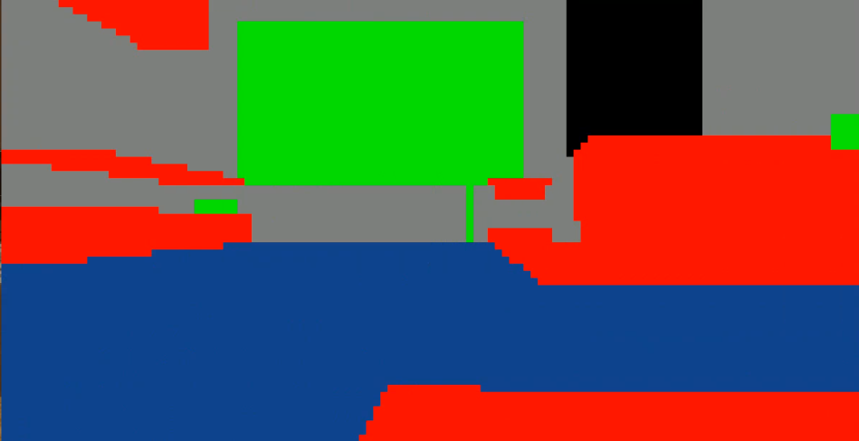
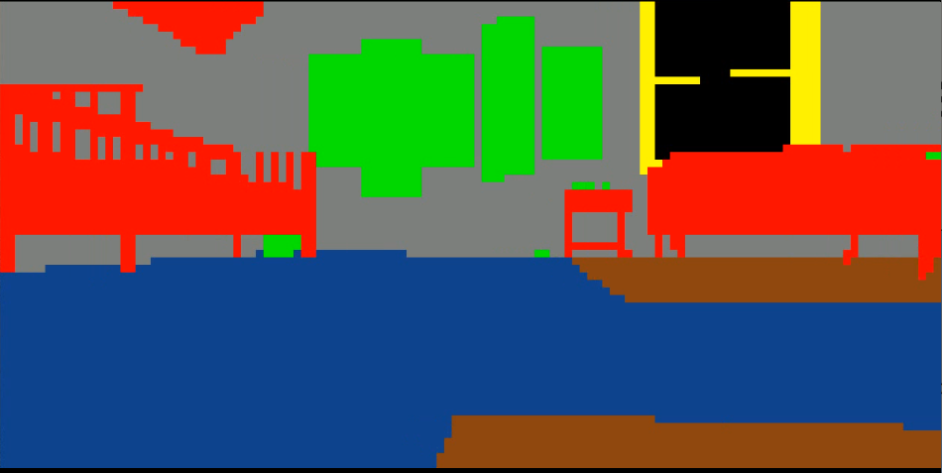
Generating synthetic data with Unity

Slide 9
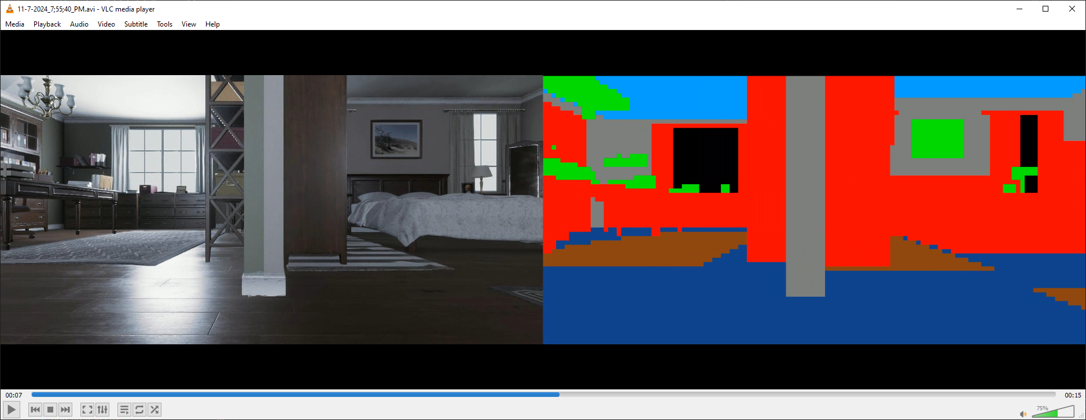
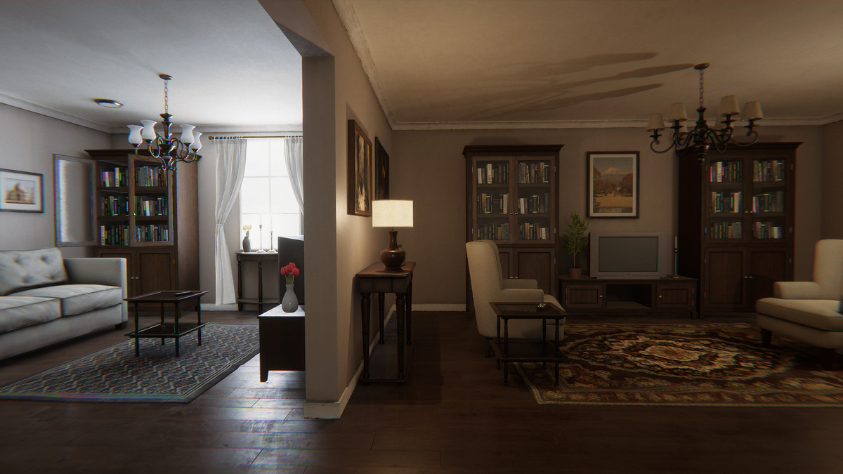
House scene
Screenshot one of a house scene + its annotations
Screenshot two of a house scene + its annotations

Slide 10
Models and accuracies
MLP
MLP + Grid Locations
Shuffled data
Accuracy: 50%
Accuracy: 60%
Accuracy: 76%
Training: ordered
In: 10x10 grid
Out: classification
Training: ordered
In: 10x10 grid, relative (x, y) of grid location
Out: classification
Training: random
In: 10x10 grid, relative (x, y) of grid location
Out: classification

Slide 11
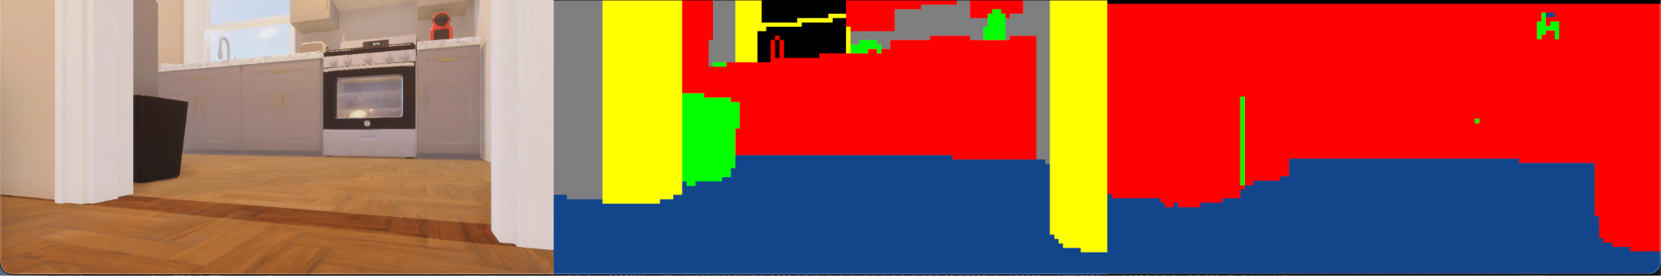

Training image test
H stack’d OG, predicted, accuracy black and white + cv2 text that shows accuracy in percentage - do an image that did really well

Slide 12
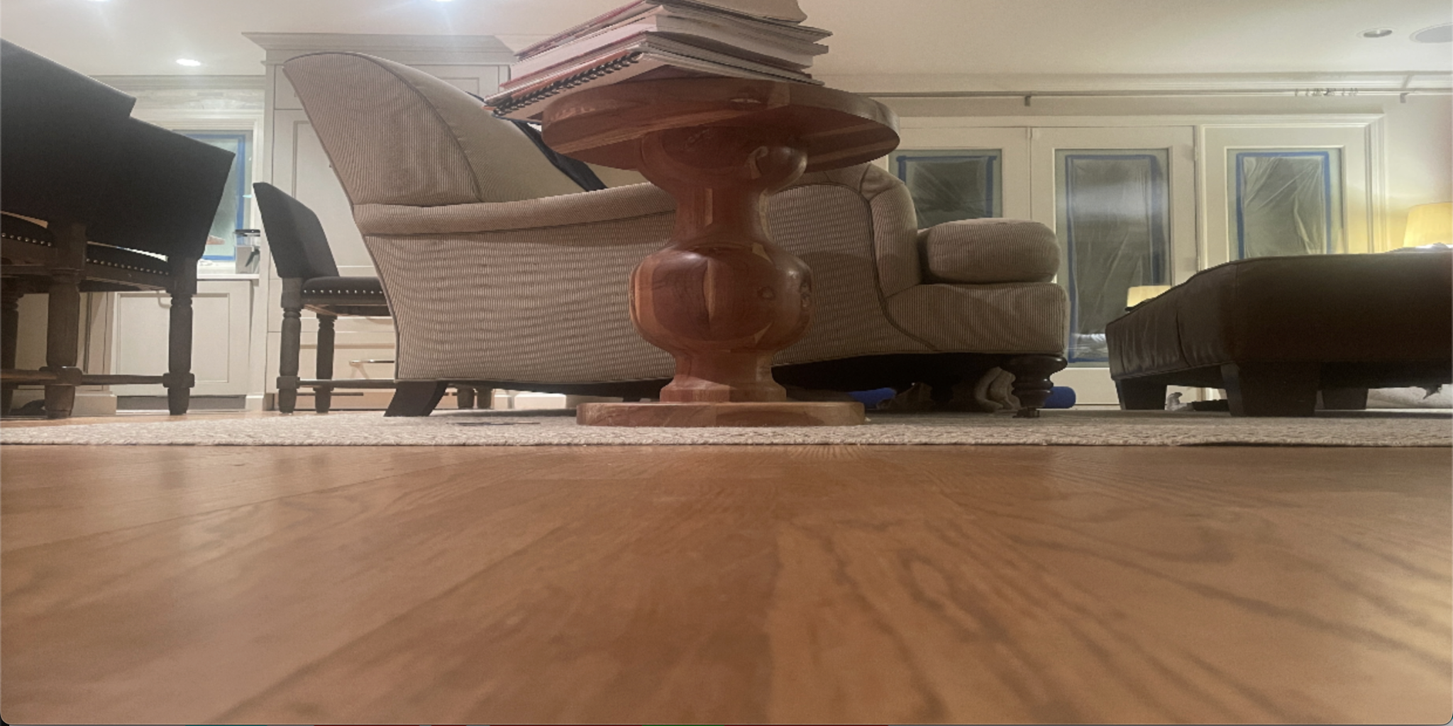
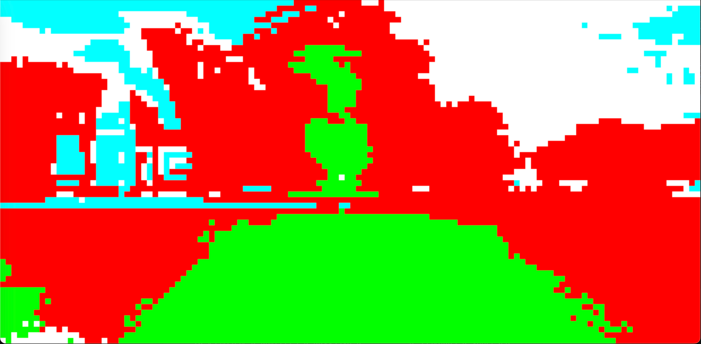
First tests
Distinguished between parts of the scene
Sensitive to light differences
Somewhat accurate labels

Slide 13
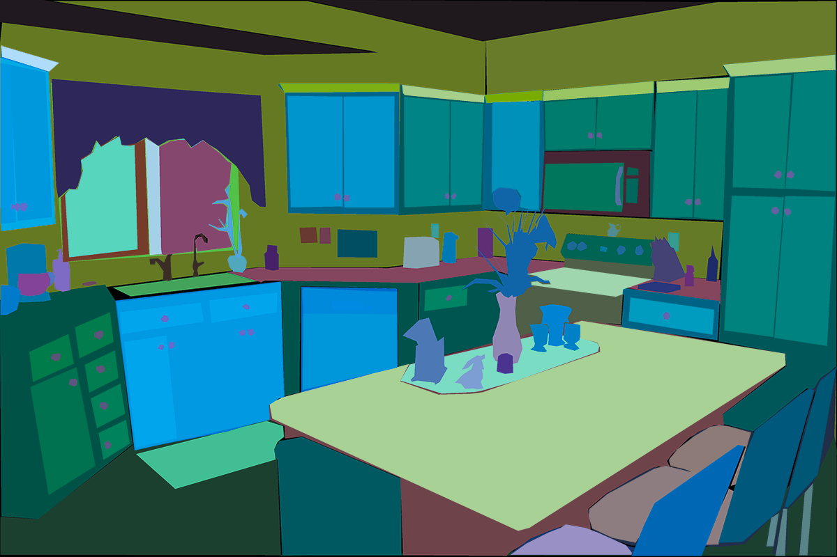
Attempts at raising accuracy
Ade20k data
Overfit prevention
Trinary output
All 3 combined
Accuracy: 58%
Accuracy: 59%
Accuracy: 68%
Accuracy: 68%
Randomly changing brightness, zoom of training images
Permanent, semi-permanent, dynamic
More accurate with real data

Slide 14
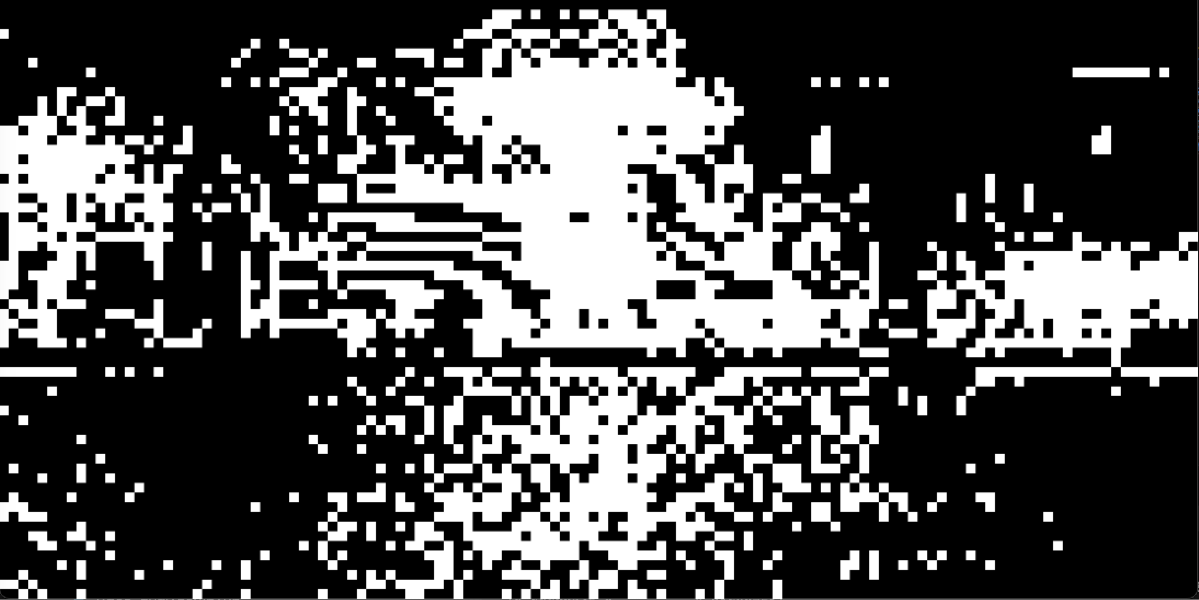
Next tests
Last couch picture from scout
Recognized each foreground object
Still inaccurate on the floor
Practically useful
Predicted couch picture with new model

Slide 15
Demonstration

Slide 16
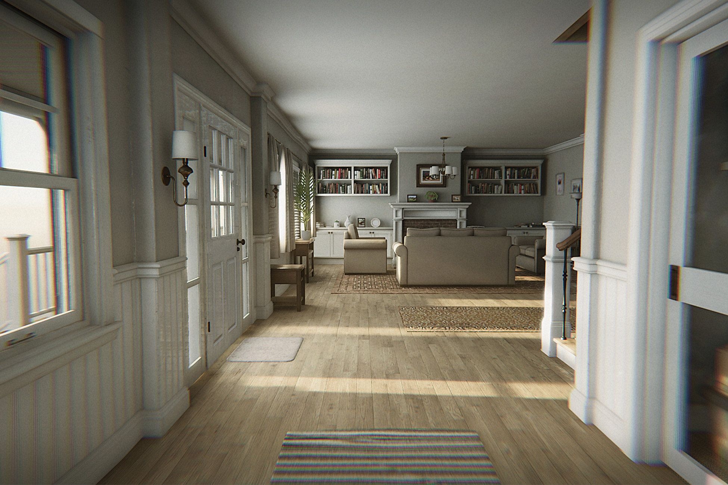

Future plans
Pictures from other datasets + super realistic unity house scenes on the asset store
More Data, synthetic and real
Different model approach
Model optimization for efficient predictions

